Slide 1


CANARA ENGINEERING COLLEGE
Sudhindra Nagara, Benjanapadavu, Mangalore– 574219, D.K Karnataka
DEPARTMENT OF COMPUTER SCIENCE AND ENGINEERING
Memesense:Tone-Based Meme and GIF Detection Using Generativ AI
Team ID: CEC/CSE/2026-27/P-21
Name: USN:
Rishika B V 4CB23CS126
Rashmitha 4CB23CS125
Rashmi K Bhat 4CB23CS124
Under the guidance of
Ms.Kavya A M
Assistant Professor, CS&E

Slide 2
Table of Content
Introduction
Problem Statement
Literature Survey
Objectives
Scope
Requirements
Expected Results
Conclusion
Result

Slide 3
Introduction
Memes and short videos are one of the most popular ways people communicate online. They are not just funny images or clips they often carry hidden tones like sarcasm, humor, motivation, or even offensiveness. Traditional AI tools struggle to catch these hidden meanings, especially when visuals, text, and audio are mixed together.

Slide 4
Literature Survey
Old AI methods for memes worked okay but missed hidden context (like sarcasm, jokes).
They were also slow, heavy, and needed big datasets.
The new paper’s idea- two steps:
1. Use BLIP-2 + GPT-4 → understand meme (image + text together).
2. Use a small model (KeyBERT + Transformer) → decide meme’s tone (funny, offensive, etc.).

Slide 5
Author/Year. | Study/Work | Method Used | Gaps | Key Result
1.Sharma et al. (2020) | Memotion 1.0 (SemEval-2020 Task 8) | Image features (VGG) + text models (BERT), multimodal fusion for 3 tasks (sentiment, humor/sarcasm/offense/motivation, intensity). | Small dataset, English-only, models struggled with sarcasm and cultural nuances. | First benchmarks dataset and baseline modals meme analysis.
2.Pramanick et al. (2021) | Memotion 2.0 | Improved multi modal transformer pipelines ensem -bles for the same Memotion task. | Still relied on heavy multimodal models; limited explainability; compute-intensive. | Better accuracy across benchmarks compared to Memotion 1 baselines.
3.Mishra et al. (2023) | Memotion 3.0 (Hinglish Memes) | Multilingual text encoders + multimodal architectures for Hindi-English code-mixed memes. | Domain-specific dataset needed; multilingual sarcasm and humor still challenging. | Extended meme analysis beyond English; competitive results for Hinglish dataset.

Slide 6
Author/Year. | Study/Work | Method Used | Gaps | Key Result
4.Menon & Vondrick (2022) | Explainable Meme Understanding | Used Vision Transformer (ViT) + DeBERTa; generated textual explanations (hero/villain/victim roles). | Role-focused dataset, not aligned with Memotion tasks; requires new labeled data. | Improved interpretability of meme classification decisions
5.Xu et al. (2022) | Meme Analysis with VQA + GPT-3 | Visual Question Answering (VQA) to generate answer candidates, then GPT-3 to analyze context for classification | Multi-stage and inefficient; GPT-3 outputs verbose, making classification harder. | Showed LLM reasoning can enrich meme understanding beyond raw vision-text fusion.
6.Wu et al. (2021) | Metaphor & Multilingual Meme Analysis | VGG image encoder + Multilingual BERT text encoder for metaphor recognition and Chinese memes. | Required new datasets; not directly applicable to Memotion benchm-arks. | Pushed meme research beyond English; detected figurative language.

Slide 7
Author/Year. | Study/Work | Method Used | Gaps | Key Result
7.Multimodal Understanding of memes with Fair Explanations (2024). | Explainability & bias in meme classification. | They use pretrained Vision-Language (VL) models to generate explanations for memes (image + text). | Addresses explainability gap. | Benchmarks explanation generation & fairness.
8.PromptMTopic (2023). | Un-supervised topic modelling of memes. | They propose a prompt-based framework: extract visual semantic information by captioning images. | Addresses cultural/context and evolving themes. | Thematic clustering of memes via image+text.
9.A Multimodal Memes Classification: Survey (2023) | Survey & open issues in meme classification. | They introduce a novel dataset of memes, then build a model called MemeCLIP. | Helps frame overall gap (sarcasm, multilinguality) | Reviews datasets, methods, challenges.
10.MemeCLIP (2024). | CLIP-based model + new dataset | Works on multimodal meme classification: datasets, tasks | Advances fusion models; social subset. | Multi-aspect meme classification (humour, hate)

Slide 8
Scope
Our project will focus on short video memes, analyzing frames, audio, and text to detect tones like humor, sarcasm, motivation, or offensiveness.
It will include a prototype app that also generates captions in the same tone.
Can be applied in social media moderation, content creation, and digital marketing.

Slide 9
Objectives
To develop a model that looks at both visuals and speech of video together to detect the emotions.
To add Generative AI that creates smart captions matching the same tone of the video.

Slide 10
Requirements
Programming Language: Python 3.9+
IDE/Editors: Jupyter Notebook, VS Code
OpenCV / MoviePy → for video and audio extraction
Hugging Face Transformers (BLIP-2, Wav2Vec2, GPT, etc.) → for AI models
EasyOCR → for text extraction from frames
KeyBERT → for keyword extraction

Slide 11
Methodology
MEME GIF/VIDEO INPUT
EXTRACT VISUALS AND TEXT
TONE UNDERSTANDING
True
False
TONE=
HUMOROUS,SARCASTIC,EMOTIONAL,ECT
DISPLAY DETECTED EMOTIONS

Slide 12
Expected Outcomes
The system detects short video memes and accurately detects their emotions by combining video, audio, and text, also generating captions that match the same emotions.

Slide 13
Conclusion & References
In conclusion, Memesense offers a smart and creative way to understand the emotions behind memes and videos. It’s an affordable, easy-to-use system that not only detects tones of emotions but also generates matching captions, making it valuable for content creators, marketers, and online safety.
Future Scope:
In the future, this project can be taken further to:Work in real time on live social media videos.Handle regional languages and slang.Detect more complex tones like irony or mixed emotions.Run as a mobile app so anyone can use it easily.

Slide 14
References:
1. Khanday, A. M. U. D., & Rabani, S. T. (2023). Meme Analysis Using LLM-Based Contextual Information and U-Net Encapsulated Transformer.
2. Vaswani, A. et al. (2017). Attention Is All You Need. NeurIPS.
3. Hugging Face (2025). Transformers Library. Available at: https://huggingface.co/transformers
4. OpenAI (2025). GPT Models and Applications. Available at: https://openai.com/research
5. Kaggle (2024). Meme and Video Datasets. Available at: https://www.kaggle.com/datasets

Slide 15
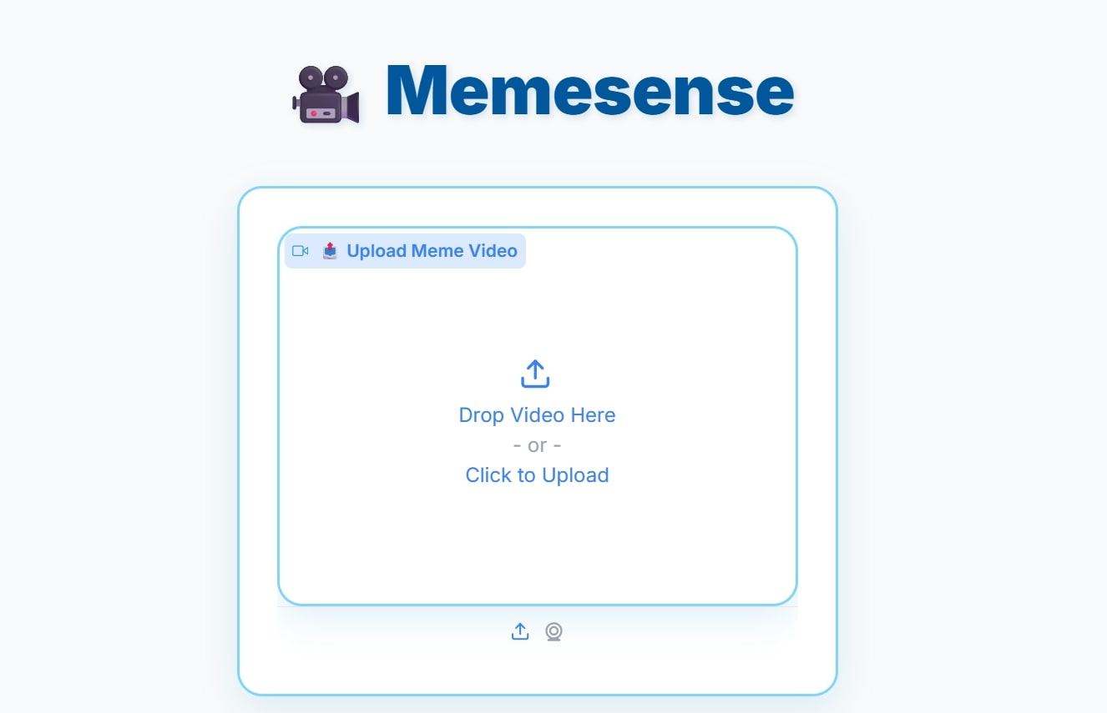
Results
1.Opening gardio interface

Slide 16
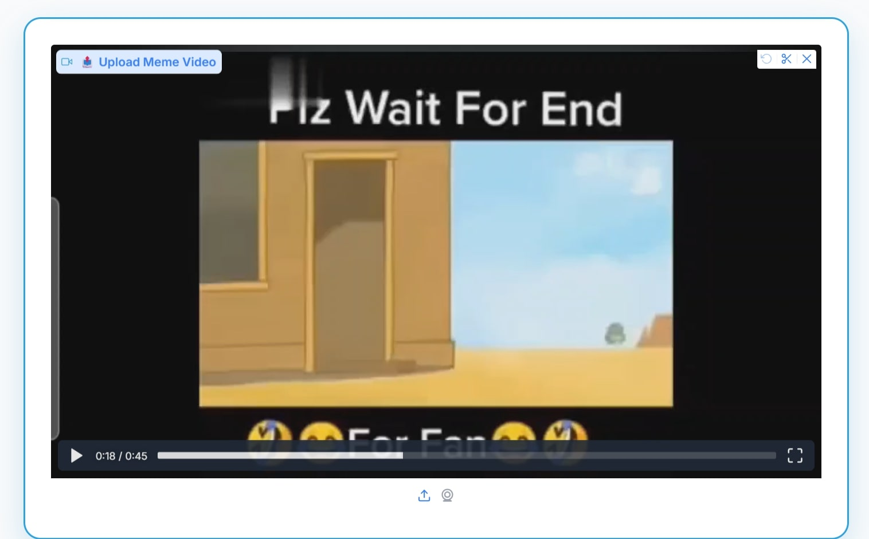
2.Uploading video

Slide 17
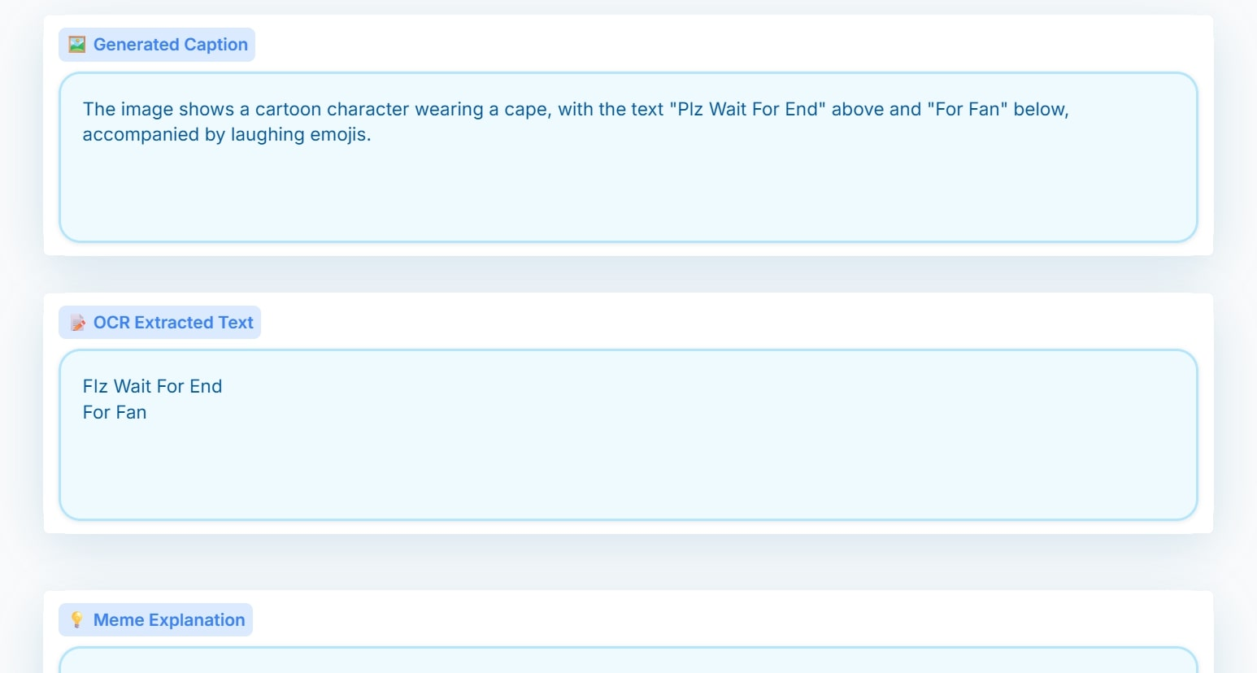
3.Extracting key Frames

Slide 18
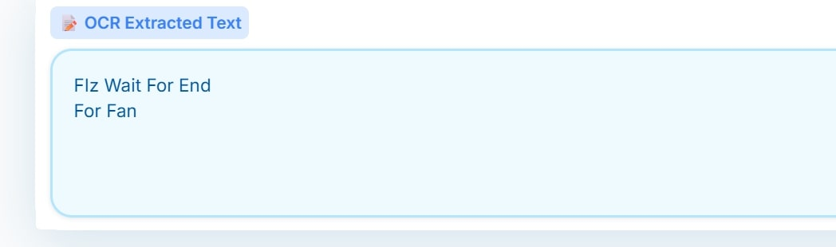
4.Text Extraction

Slide 19
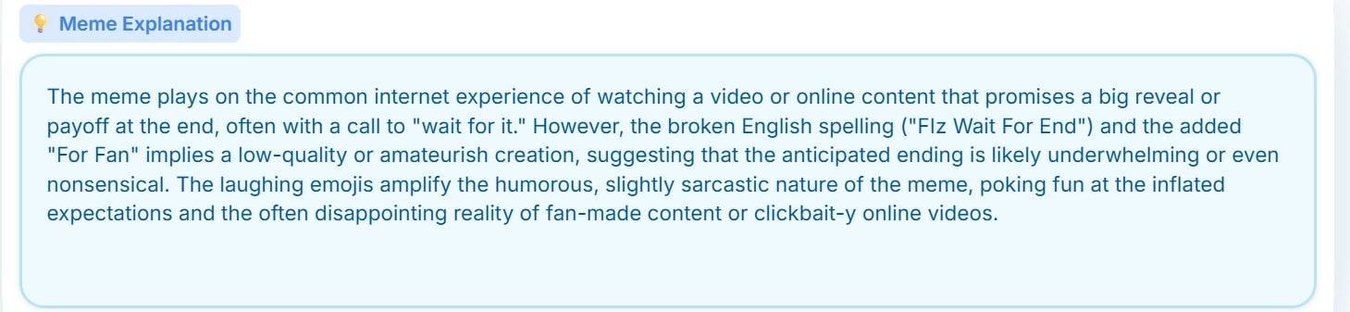
5.Meme Explanation

Slide 20
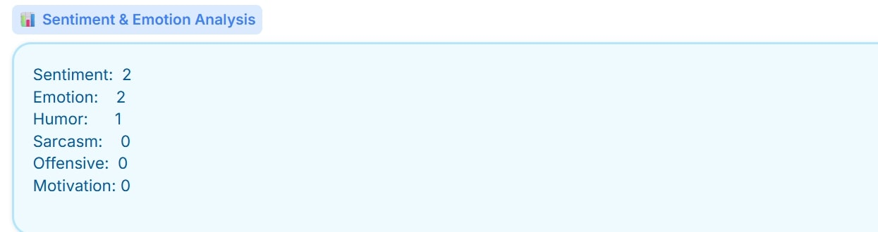
6.Sentiment Analysis

